Slide 1
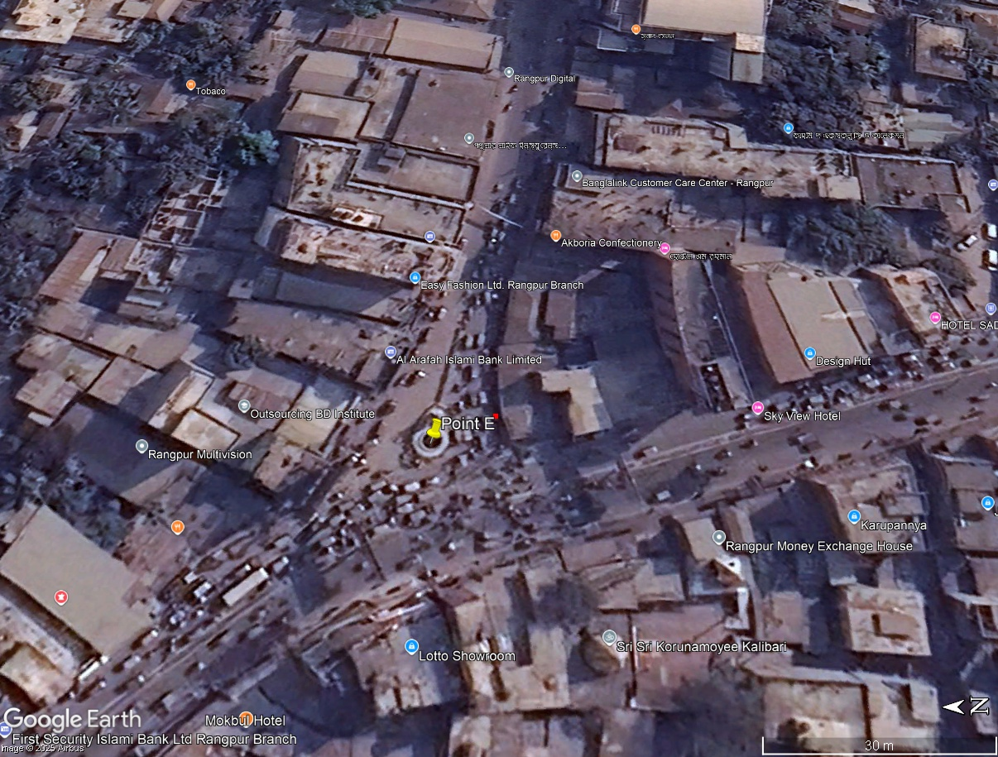






Slide 2






Slide 3
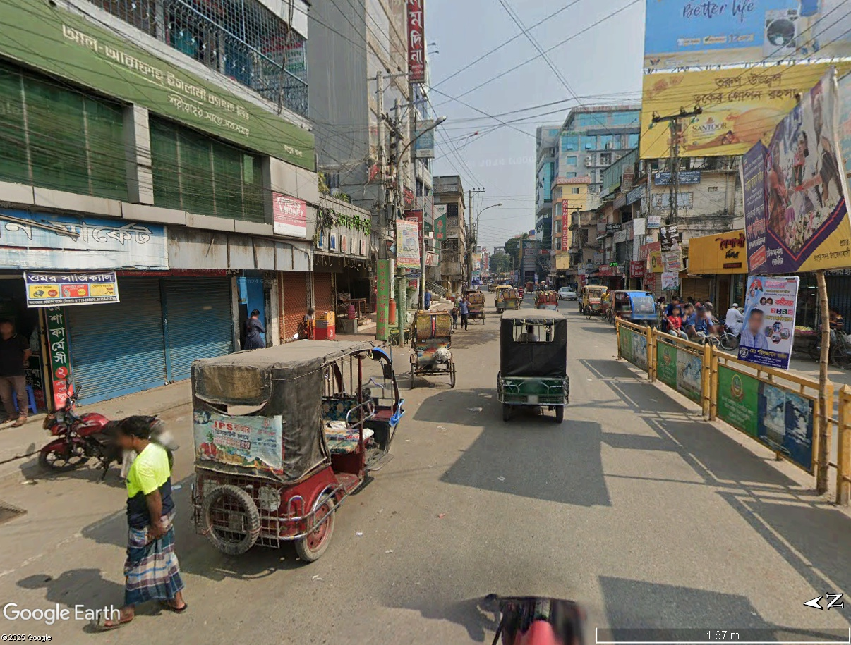





road marker is faded
Road median should not be sharp at start
semi motorized vehicle use this spot for pickup and dropping passenger.
road side are being used as parking, increasing side friction

Slide 4
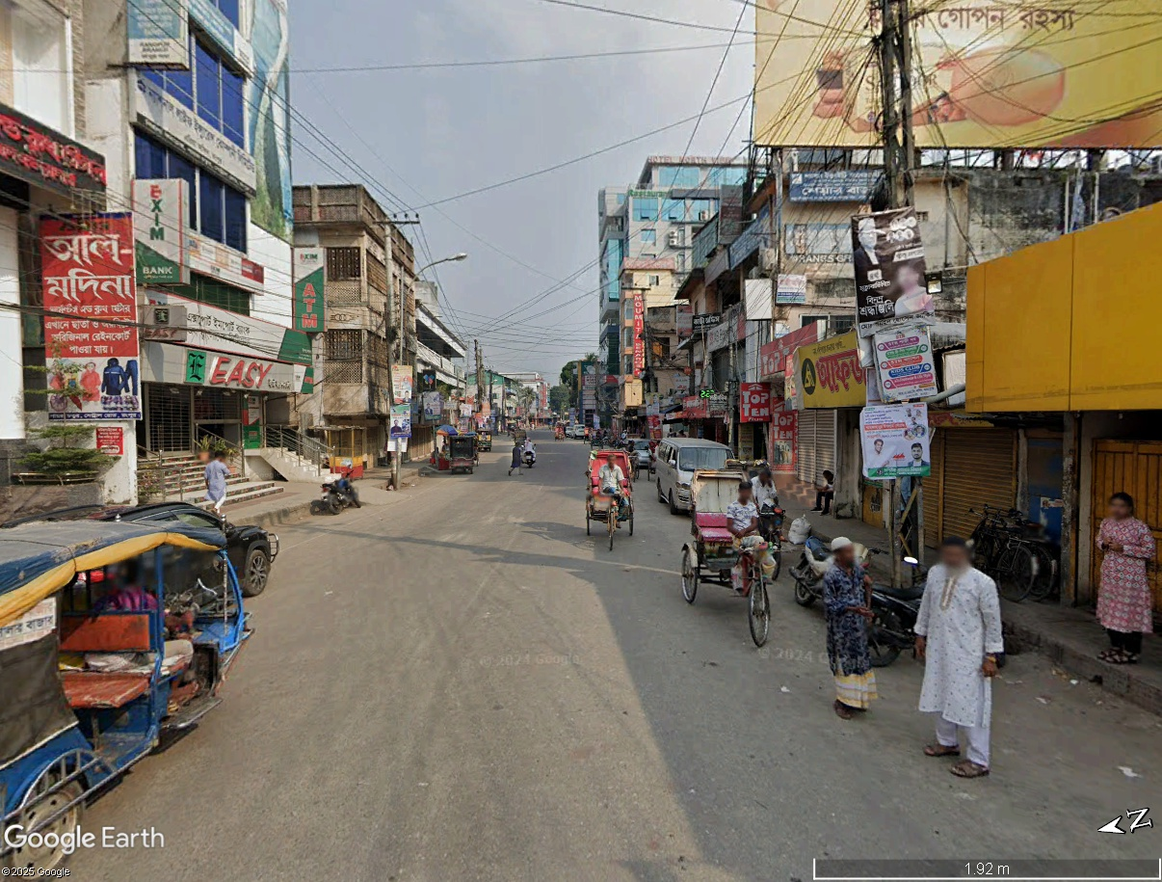












footpath is occupied for illegal parking and as a result pedestrian are using road

Slide 5
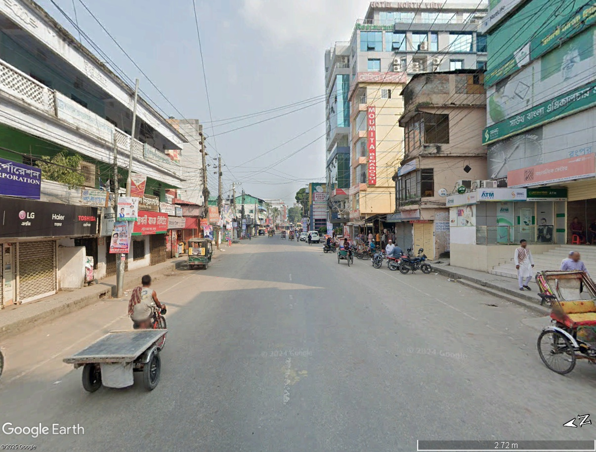


electric poll on the top of road may cause fatal crash

Slide 6
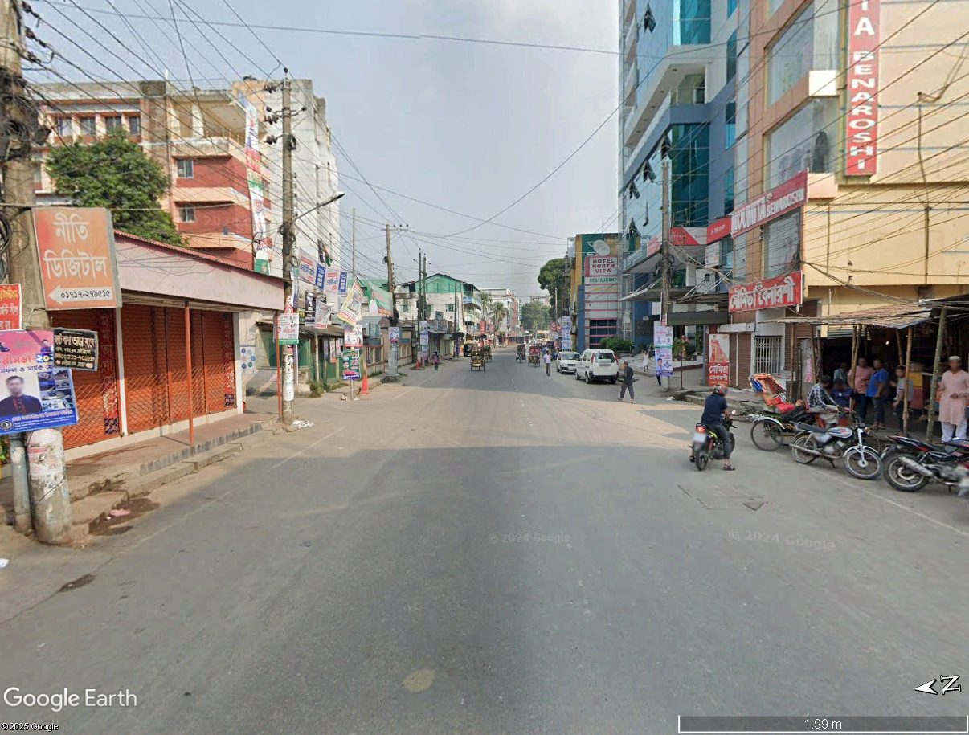

Slide 7
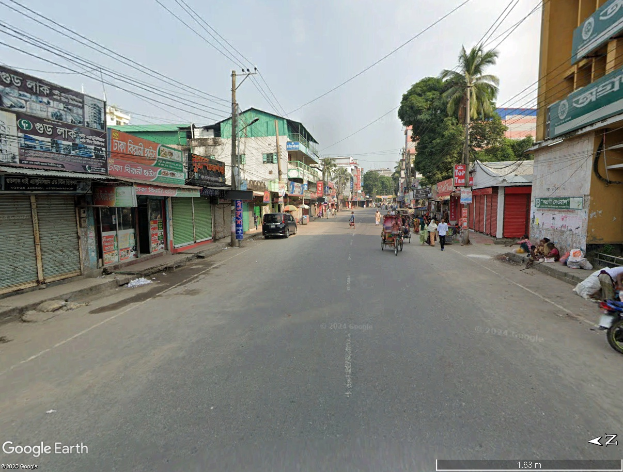





electric poll on the top of road
footpath are occupied by homeless people
Not a pedestrian friendly footpath

Slide 8
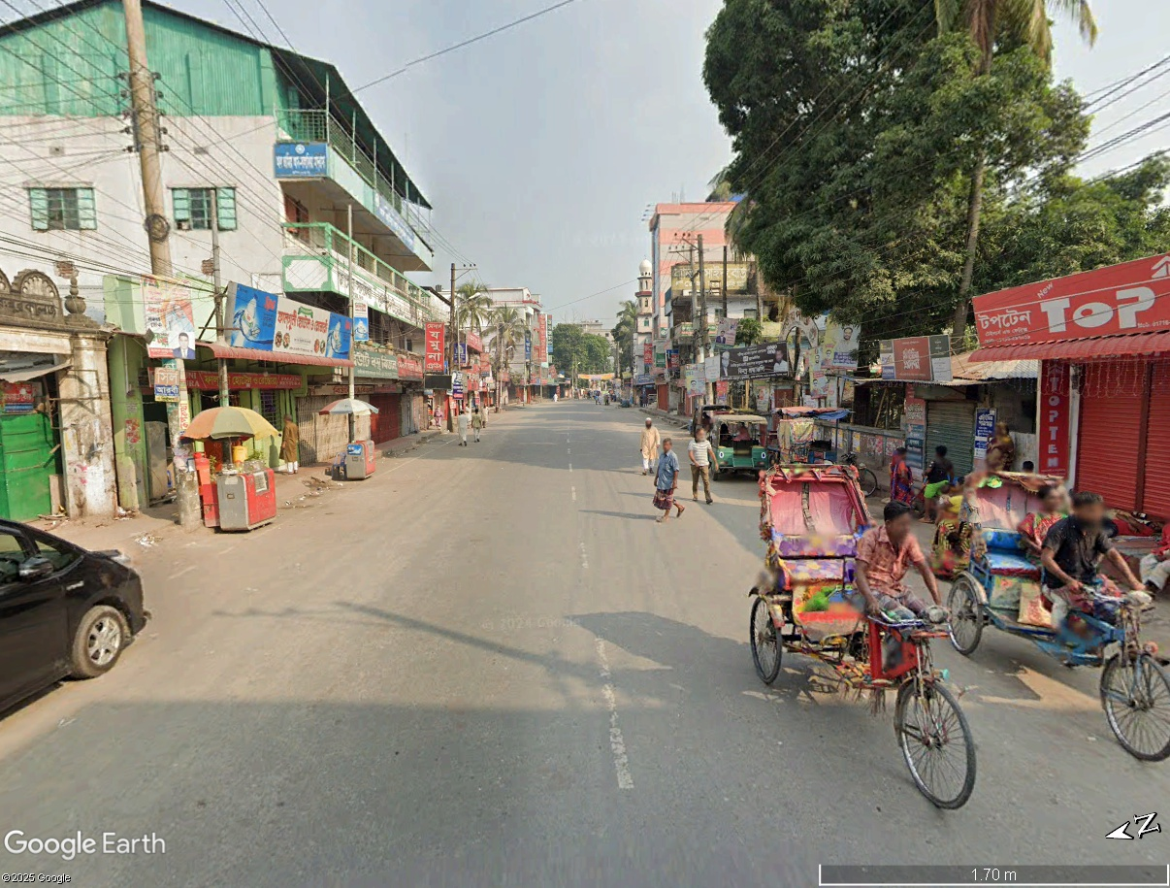






high volume of pedestrian , but no zebra crossing
illegal shops, create side friction

Slide 9
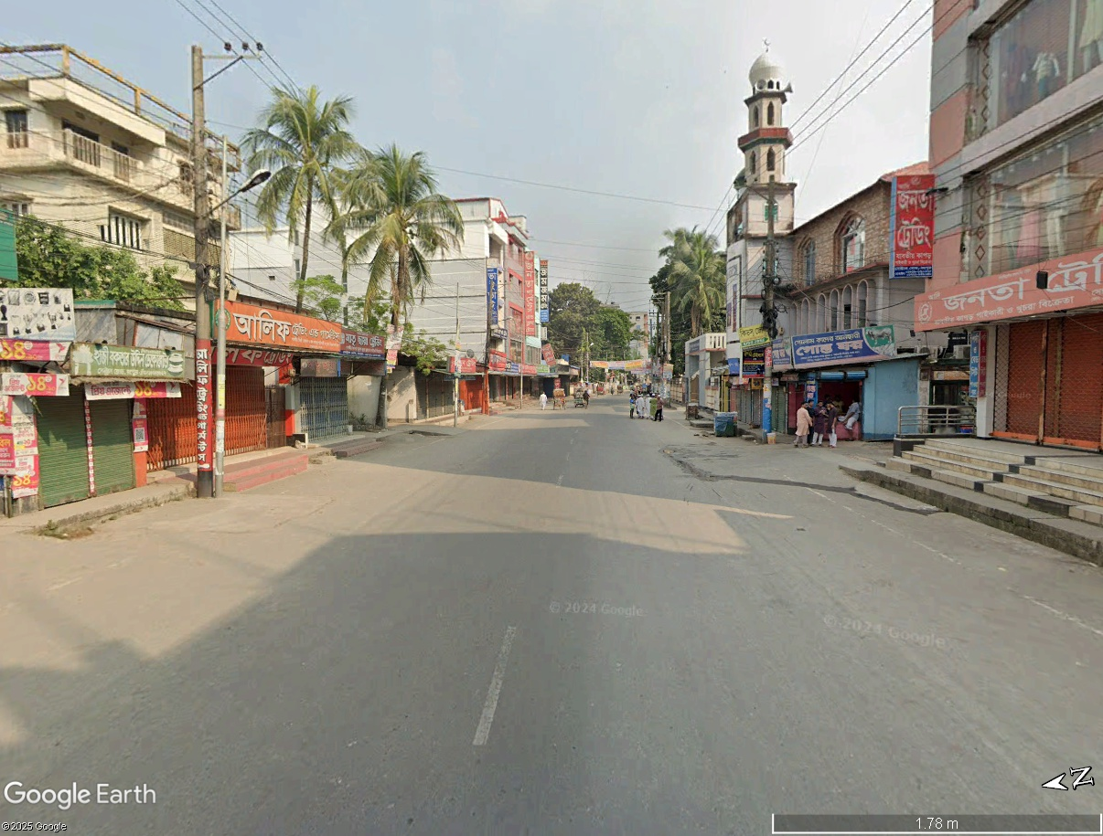


road marking is not visible , so imaginary road marking is provided

Slide 10
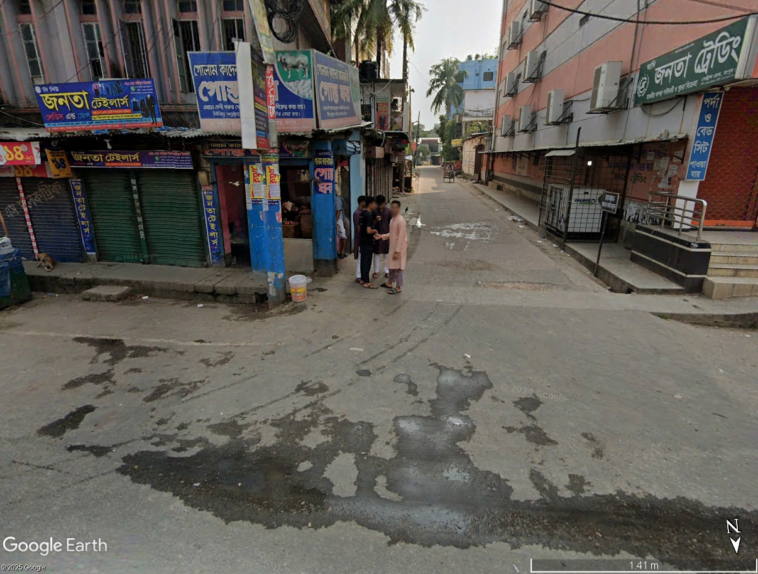

No sign for driver About this T section

Slide 11
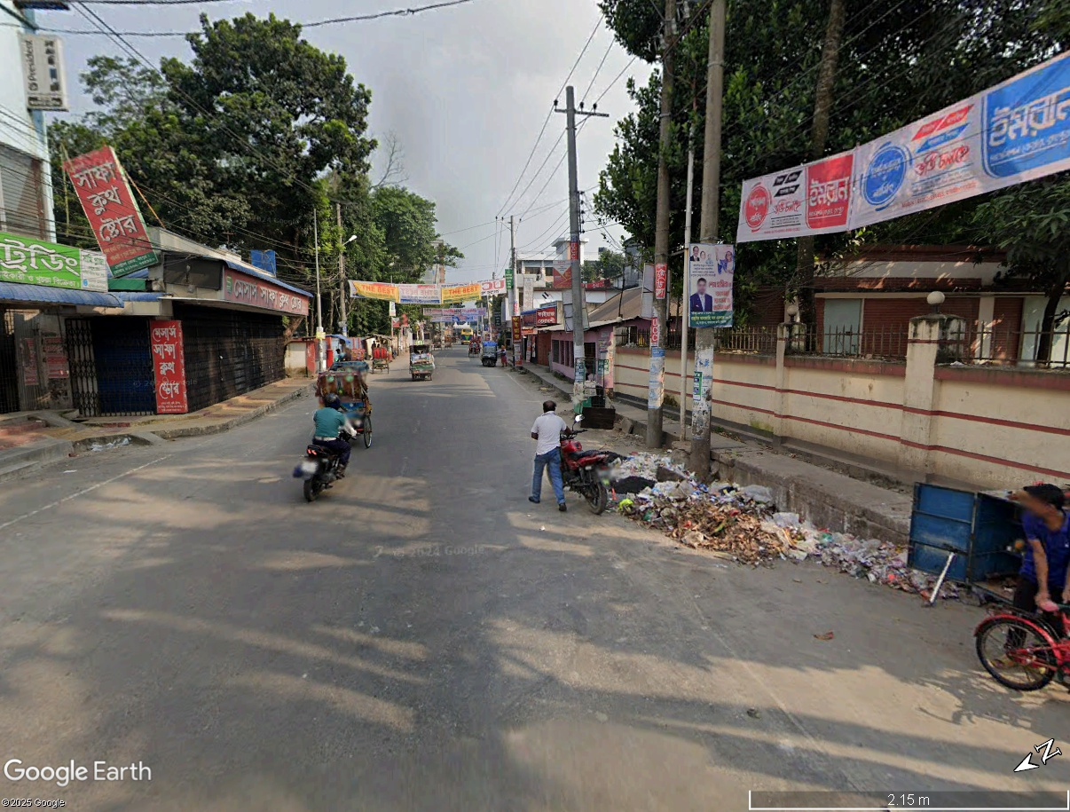


Slide 12
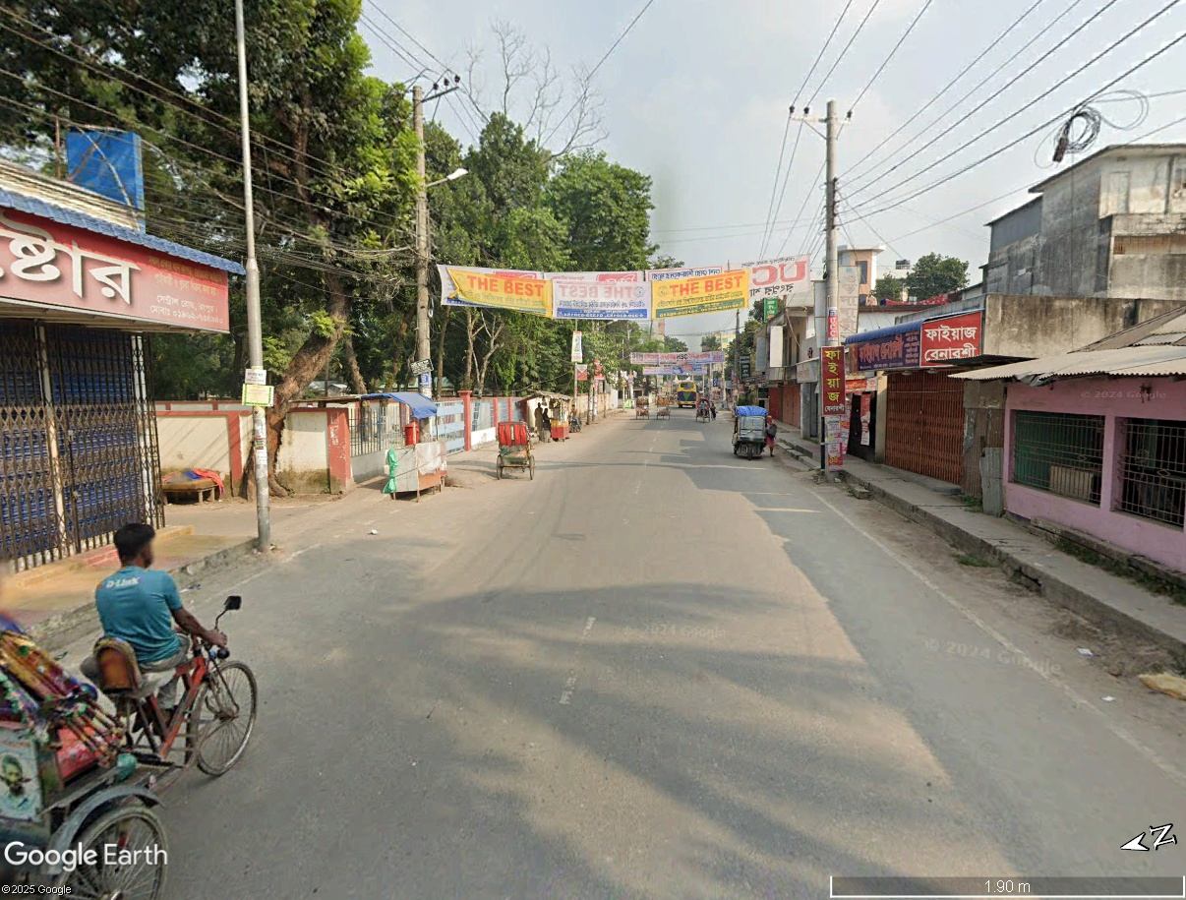



Slide 13
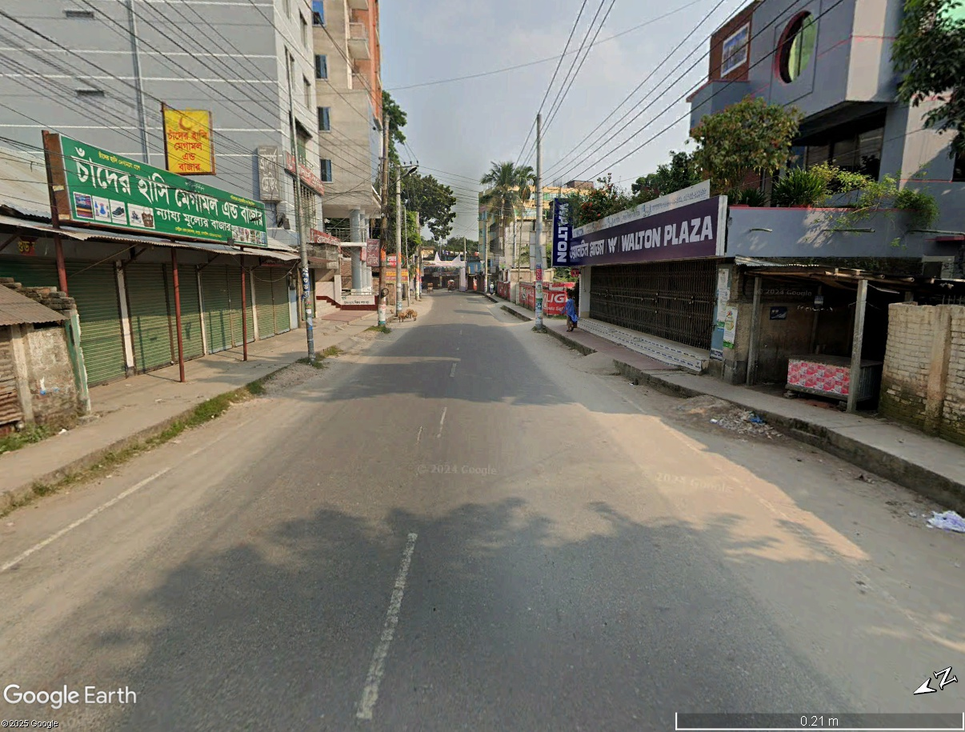



- Electric polls are directly on the road
- Roadside marker faded

Slide 14
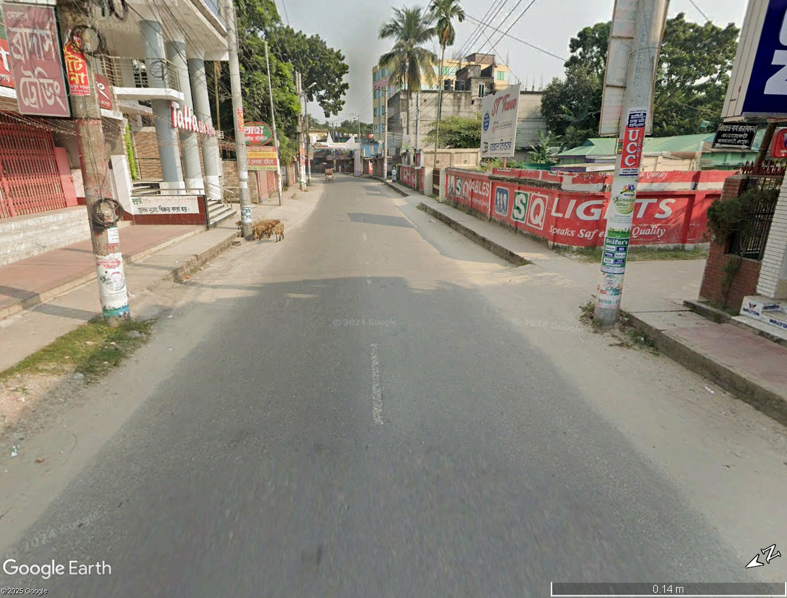



- All the electric polls are in bad position, hazard
- Road markers are faded, washed away

Slide 15
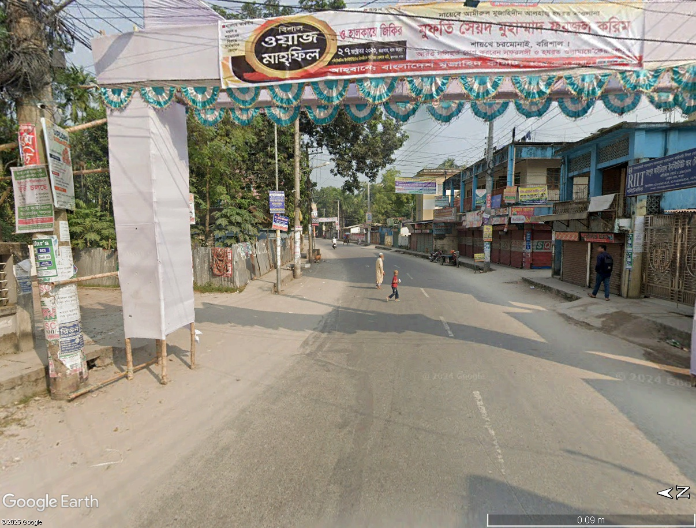


Slide 16
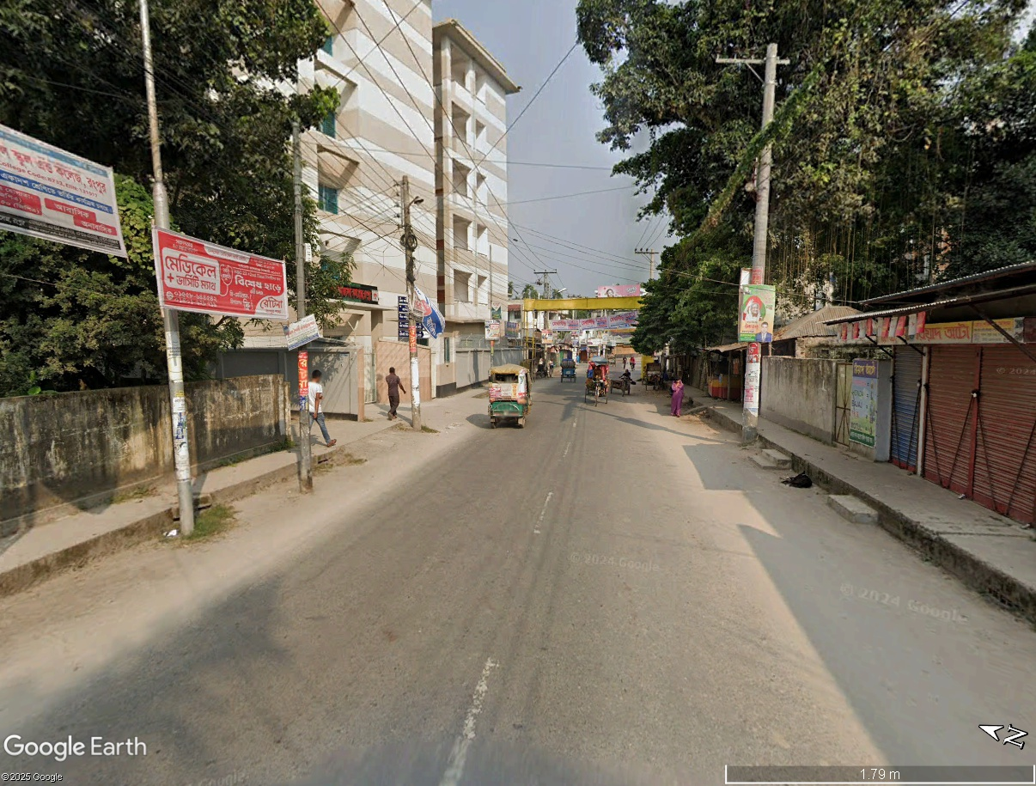

this road is not visible from a distance, no warning sign
Roadside markers faded

Slide 17
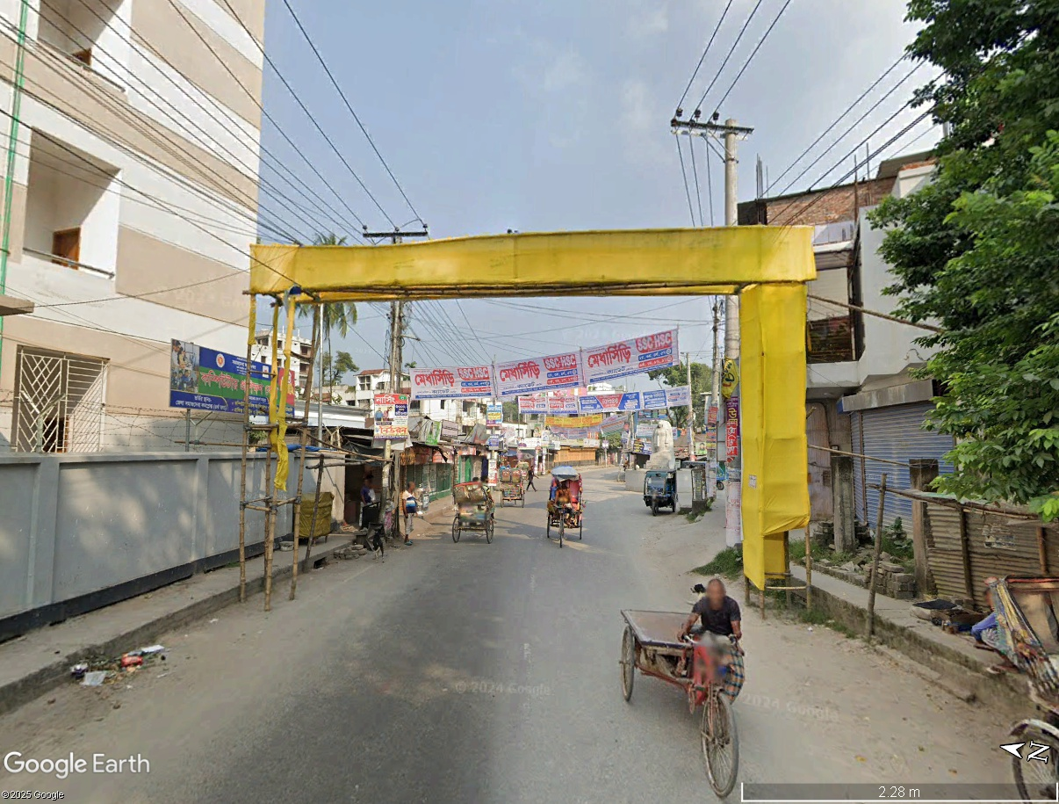




Slide 18
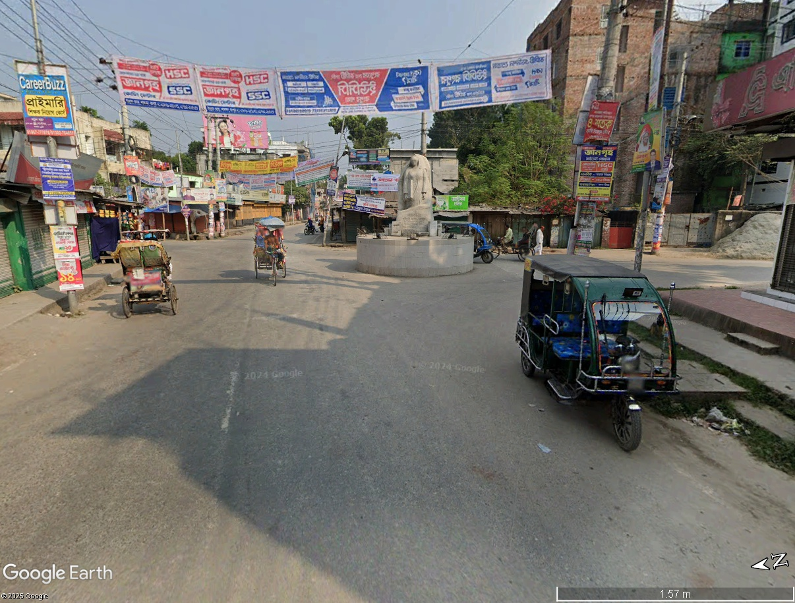


Slide 19
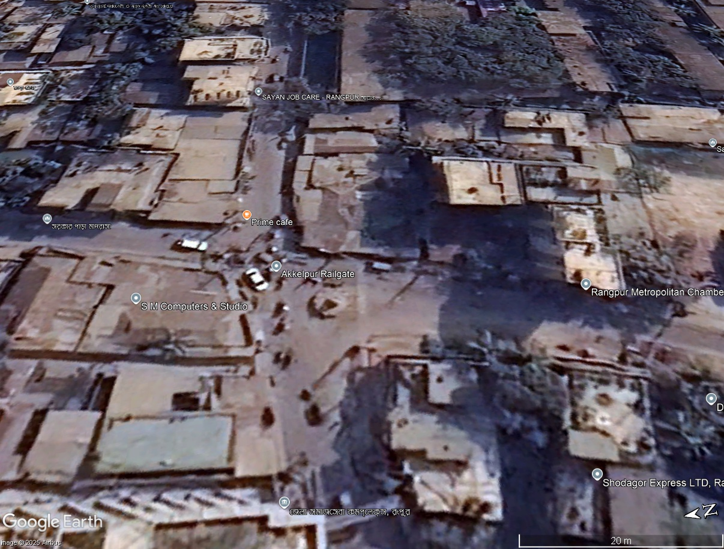



the alignment of the roundabout is not proper

Slide 20







Slide 21
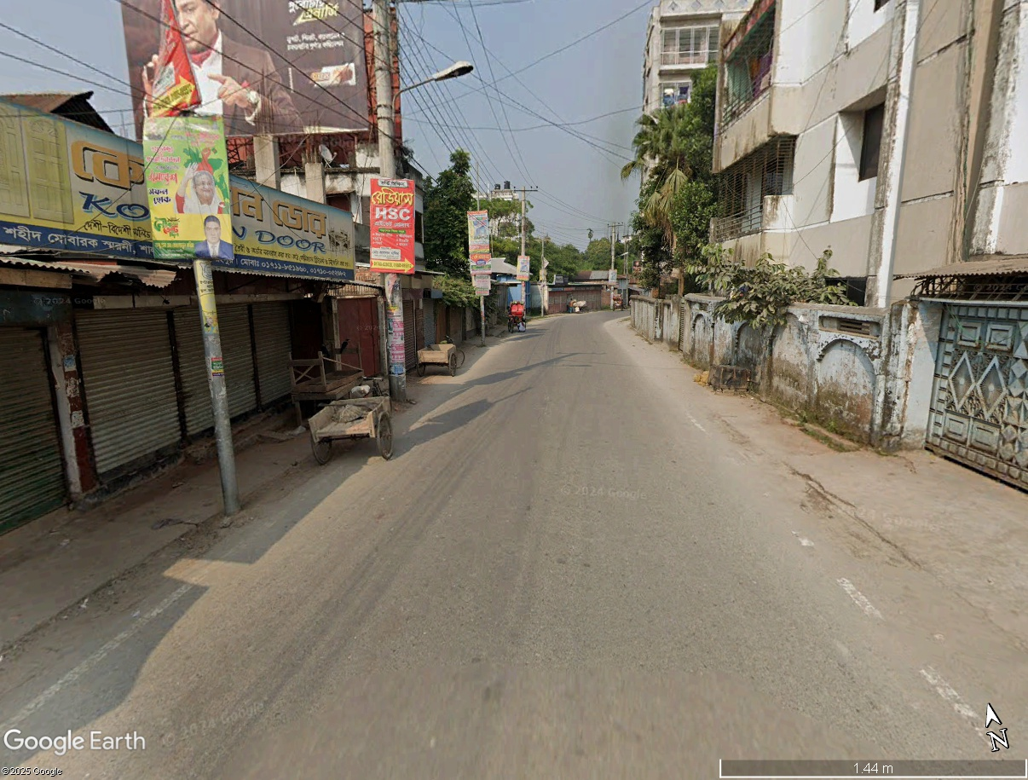







Slide 22
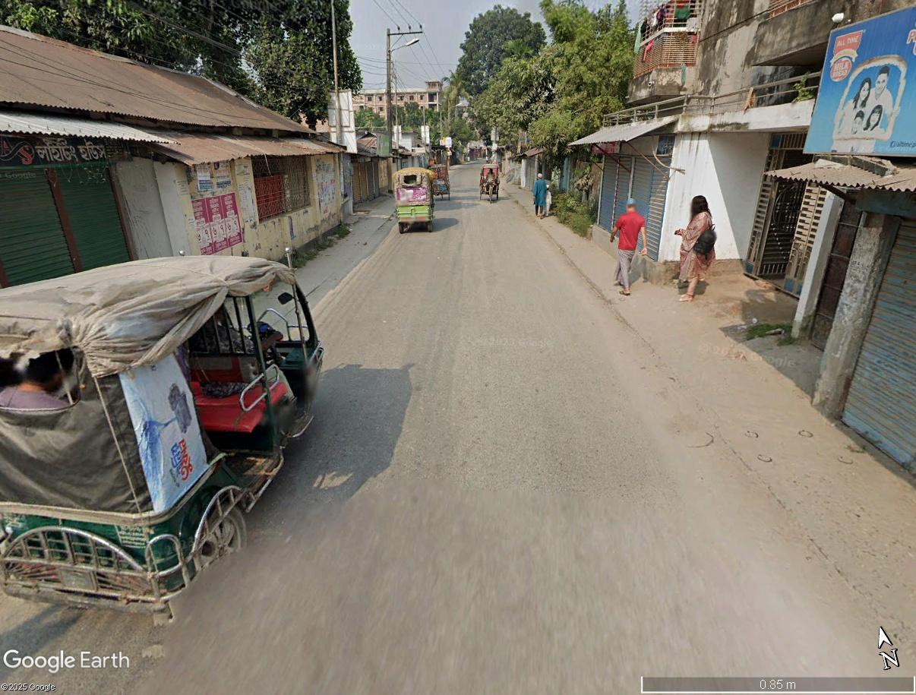
- road marker are not visible, faded away
- no drainage system exist

Slide 23
